Slide 1
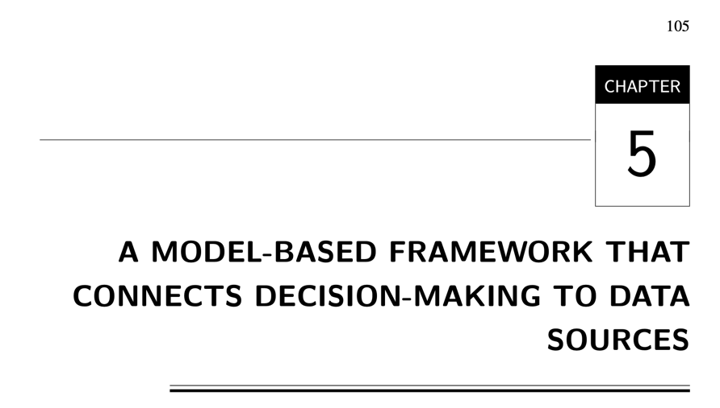

Slide 2
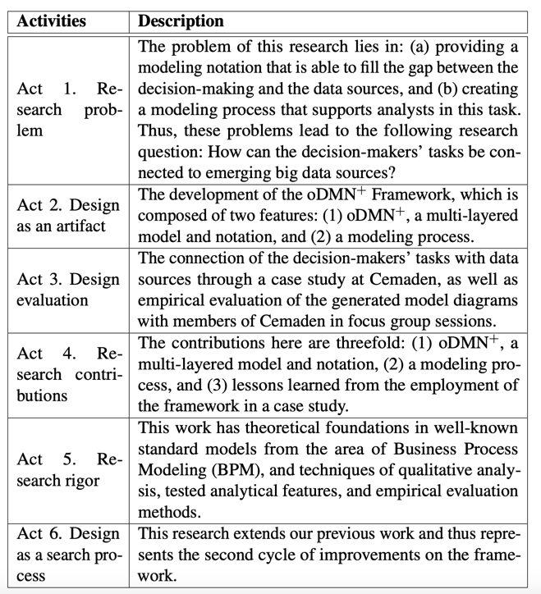

Slide 3

1 - Research Problem

Slide 4

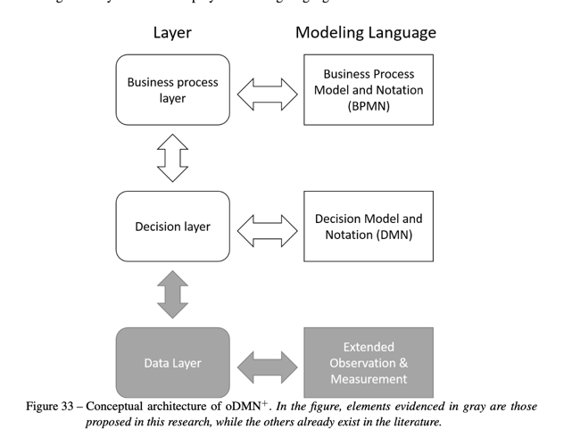
2 – Design as an Artifact

Slide 5
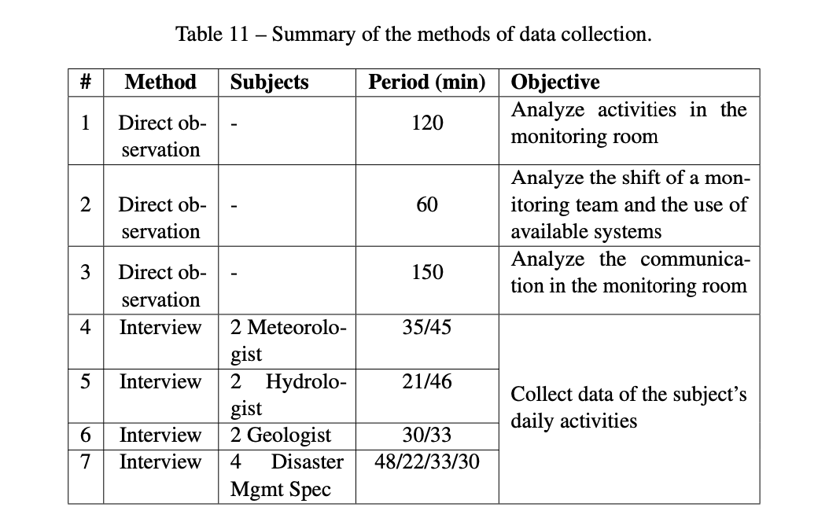
Observação, e questionario

